Slide 1
AUGMENTED POPULATION BASED TRAINING (APBT)
Josias Moukpe • 4-27-2022

Slide 2
OUTLINE
Problem
Related Works
Approach
Operators
Evaluation Criteria
Results – Tennis
Results – Iris
Results – Identity
Discussion – Advantages
Discussion – Drawbacks
Observations
Summary

Slide 3
Problem
Searching and Tuning Neural Nets is a difficult and long process!
Artificial Neural Nets (ANN) are very powerful function approximators
To use effectively, ANNs require lots of hyperparameters to tune (6+, too much to exhaustively search!)
Moreover, finding the right topology is even more important and difficult. Wrong topology invalidates best hyperparameters…

Slide 4
Related Works
Manual, Grid
[4] Bergstra, James, and Yoshua Bengio. “Random Search for Hyper Parameter Optimization.”
[5] Real, Esteban, et al. “Regularized Evolution for Image Classifier Architecture Search.”
[7] Jaderberg, Max, et al. "Population based training of neural networks."

Slide 5
Approach
We propose Augmented Population Based Training!
Leverage power of Genetic Algorithms to help search both topology and hyperparameters in SINGLE joint training process.
Produce optimal topology (high accuracy, low size) trained on optimal hyperparameter schedules (adaptive, not just one value)
Requires fewer hyperparameters (3 at most, 2 usually!)
Can be parallelize for speed boost.
Better than manual, grid, and random search

Slide 6
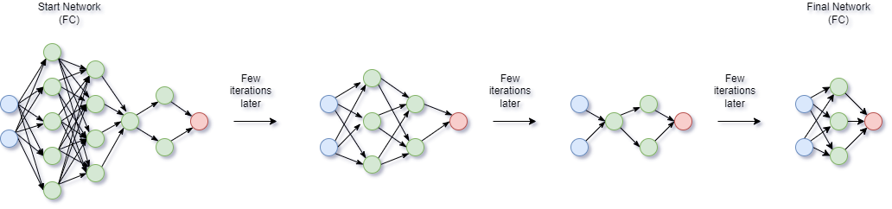
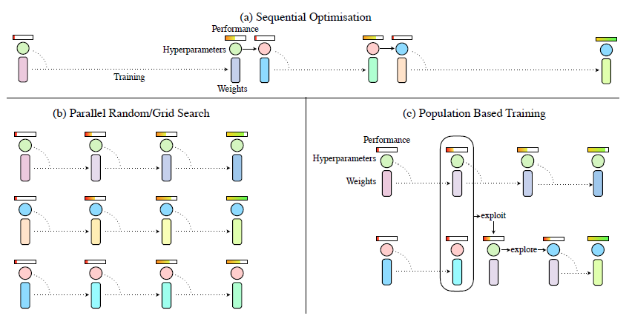
Illustrations

Slide 7
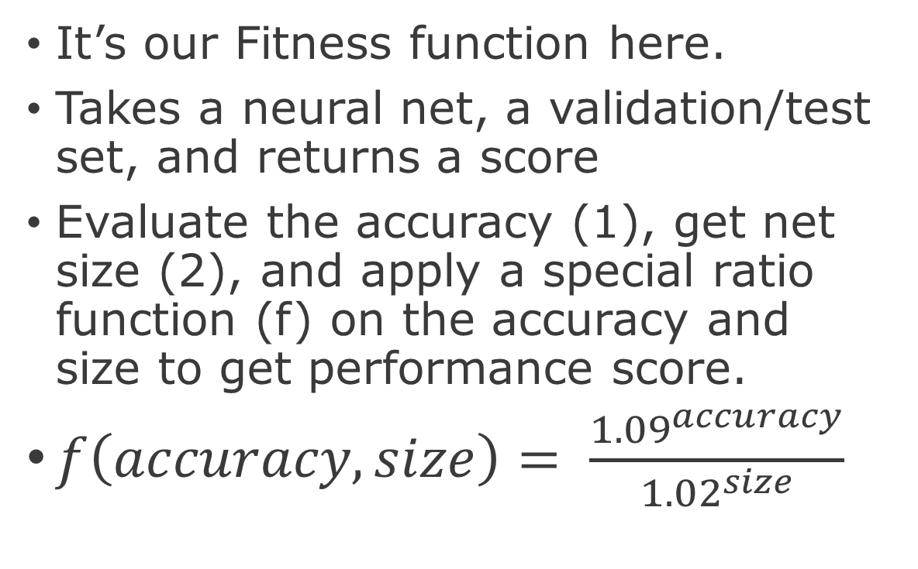
Evaluate
Augmented
Population
Based
Training
Operators
It’s our Fitness function here.
Takes a neural net, a validation/test set, and returns a score
Evaluate the accuracy (1), get net size (2), and apply a special ratio function (f) on the accuracy and size to get performance score.
$f\left(accuracy, size\right)= \frac{{1.09}^{accuracy}}{{1.02}^{size}}$

Slide 8
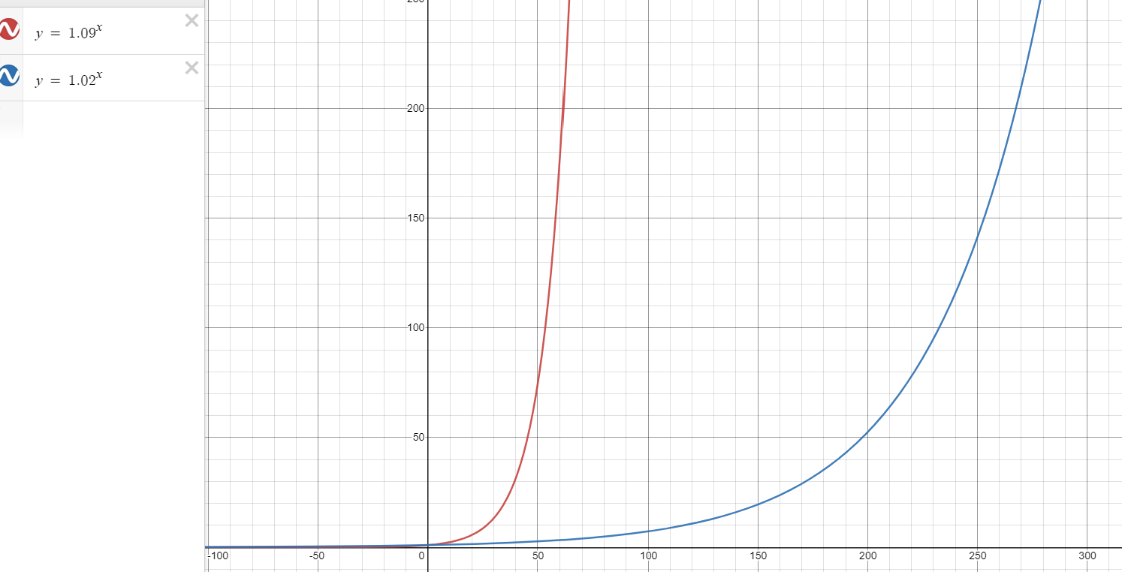
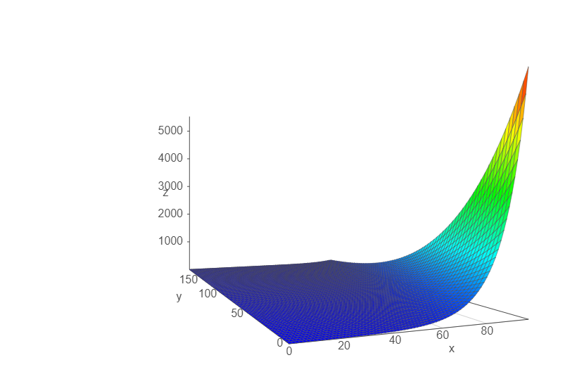
Ratio F

Slide 9
Truncation Selection
Augmented
Population
Based
Training
Operators
It’s our selection function based on the readiness threshold.
A neural net is simply “ready” after a set number of iteration has elapsed since last time it was ready
Truncation selection works by first ranking the nets in the population by performance ratio. If current net is in the bottom 20% of the population, we sample another net uniformly from the top 20% of the population to exploit.

Slide 10
Exploit
Augmented
Population
Based
Training
Operators
It’s our crossover function.
When a net is ready after a certain number of iterations, and is struggling in performance (bottom 20%), it can exploit the rest of the population by copying the topology, weights, and hyperparameters of the top net selected from the population with truncation selection.

Slide 11
Explore
Augmented
Population
Based
Training
Operators
It’s our mutation function.
Following exploitation, the net experiences a perturbation in its hyperparameters, and topology before continuing training with the new hypermeters and topology.
Hyperparameters are multiplied by either .8 or 1.2 [7]
Topology either gains a neuron, loses a neuron, or does nothing.

Slide 12
Evaluation Criteria
Top accuracy, effective accuracy
Network size
Performance measure based on accuracy-size ratio f
Datasets: Tennis, Iris, Identity

Slide 13
Results
Tennis Dataset

Slide 14
Results
Iris Dataset

Slide 15
Results
Identity Dataset

Slide 16
Results

Slide 17
Hyperparameter schedules (think of what they mean)

Slide 18
Works quite well in optimizing topology and hyperparameters!
Provides both absolute highest accuracy net and highest accuracy with lowest size net.
Trains ANN adaptively on hyperparameter schedules as opposed to values for efficient training
Requires much less tunable parameters.
Found 10.2.2 at 96% on Tennis
Not sensitive to local minima or overfitting
Can be parallelized
Discussion: Advantages

Slide 19
Discussion: Drawbacks
APBT uses k (population size) times more space to run than BP, runs k times longer. But it can be parallelized to run much faster!
APBT is inconsistent with too small k and to small datasets
APBT struggles to find minimum size net with Identity dataset
Doesn’t support early stopping yet

Slide 20
Some Observations
Higher k the better, as long as resources allow it. Increases diversity in population
Higher Selection Readiness allows nets to train for longer before sharing. But too high readiness and it’s just k-random search.
Most effectively accurate net is not always the most absolutely accurate
Longer epochs range allow for rest of population to catch up to the top performers.

Slide 21
Summary
APBT can work really well and requires far less hyper parameters, providing the most accurate, lowest size neural net, which is trained on the optimal hyperparameter schedule.
However, APBT takes k (population size) times more space to run than BP, and without parallelism runs k times longer than BP. Can be inconsistent with smaller k and very small datasets. Struggles with Identity
In all, to solve the problem of ANN topology and hyperparameters optimization, Augmented Population Based Training is a powerful step in the right direction.

Slide 22
Thank you.
Josias Moukpe • 4-27-2022

Slide 23
References
[1] Koutsoukas, Alexios, et al. “Deep-Learning: Investigating Deep Neural Networks Hyper-Parameters and Comparison of Performance to Shallow Methods for Modeling Bioactivity Data.” Journal of Cheminformatics, vol. 9, no. 1, 2017,
[2] Mitchell, Tom Michael. Machine Learning. McGraw-Hill, 1997.
[3] Ippolito, Pier Paolo. “Hyperparameters Optimization.” Medium, Towards Data Science, 26 Sept. 2019,
[4] Bergstra, James, and Yoshua Bengio. “Random Search for Hyper-Parameter Optimization.” Journal of Machine Learning Research 13, (2012) 281-305, 2 Dec. 2012.
[5] Real, Esteban, et al. “Regularized Evolution for Image Classifier Architecture Search.” Proceedings of the AAAI Conference on Artificial Intelligence, vol. 33, 2019, pp. 4780–4789.,
[6] Gozzoli, Alessio. “Practical Guide to Hyperparameters Optimization for Deep Learning Models.” FloydHub Blog, FloydHub Blog, 1 July 2020,
[7] Jaderberg, Max, et al. "Population-based training of neural networks." arXiv preprint arXiv:1711.09846 (2017).
[8] Li, Ang, et al. “A Generalized Framework for Population Based Training.” Proceedings of the 25th ACM SIGKDD International Conference on Knowledge Discovery &amp; Data Mining, 2019,
[9] Zoph, B., and Le, Q. V. 2016. Neural architecture search with reinforcement learning. In ICLR.

Slide 24
Questions ?

